Slide 1


Understanding OCCx Cart Drop Off
Phase I Qual Topline
DRI: Kelly Peterson
Date: June 28 2023

Slide 2




Research approach
Coming Soon: Quantitative Study
Objectives for Phase II:
We conducted 8 interviews with Occasional Cx. These Cx…
Had visited the app in the past 48 hours
Had not converted on a visit in the past 48 hours
Order from DoorDash once a month or less often
Do not currently have DashPass (2 Cx had DashPass previously via free trial)
What reasons for drop off have we missed?
How do the reasons for drop off compare to one another from a frequency and size perspective? How does this differ from fees as a reason for drop off?
What levers can DoorDash pull to help Cx avoid drop off at the cart phase (and earlier)?
What are the demographic profiles of Cx who drop off at the cart phase (by reason)?
What are the attitudes of Cx who drop off (by reason) around budget, convenience, value and delivery?
The goal of these calls were to understand…
Why do OCCx drop off at the cart phase?
What do OCCx do after dropping off?
The research brief can be found here.
Notes:
James to link to failed session

Slide 3
Why do Cx drop off?

Slide 4
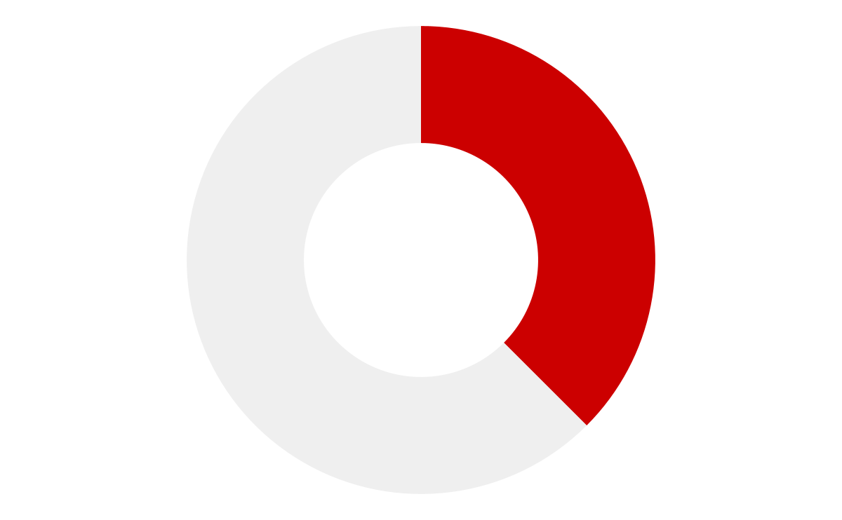




Reason 1: My promotion didn’t work
3 out of 8 Cx indicated that they tried to use a promotion code/deal that they were unable to apply to their order
Cx indicated that they typically learn about these promotions via email
Cx had double checked the fine print and felt that their promo code should have applied
Cx also noted this problem happened with a recent Jersey Mike’s BOGO offer
They indicated it’s not a frequent occurrence, but happens enough to be a frustration point with DoorDash
What if we had clearer communication if/when a promo doesn’t work and redirected Cx to evergreen savings opportunities to keep them in app

Slide 5


Slide 6
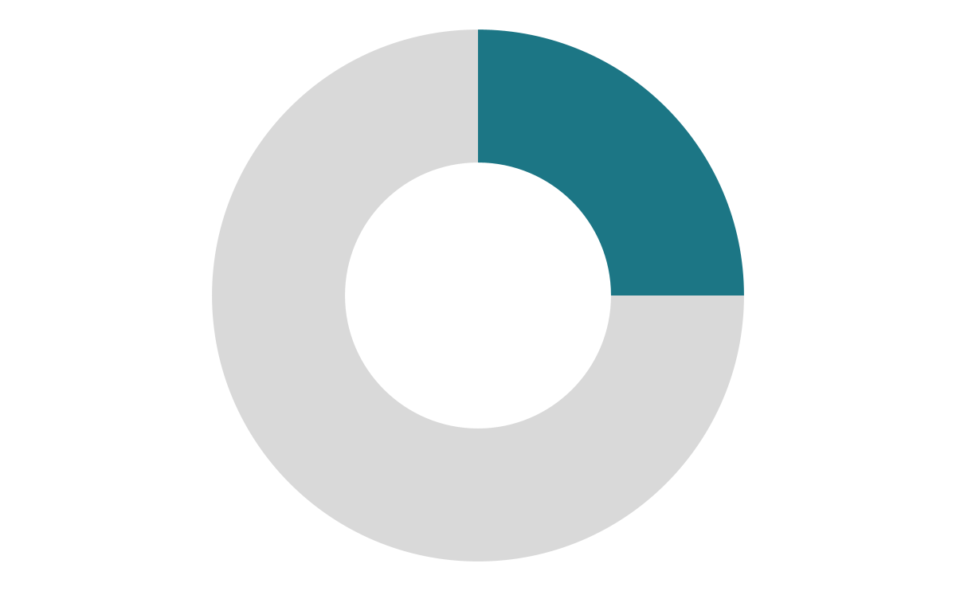


Reason 2: The final total is greater than my budgeted amount
2 out of 8 Cx indicated that they did not complete their order because the total was higher than their budgeted amount of $20
Who are these Cx?
How do they think about cost?
Live on a fixed income
Keep a budget whenever ordering out
visit the app weekly but are only able to justify spending about once per month
They live alone and are typically ordering for just themself
Look at the total subtotal to make a decision
Attribute the “expensive” nature of DoorDash to inflation + fees + tip
Often rely on promotions across apps to fit in their budget
Sometimes pay for orders with gift cards
What if we prioritized affordable meals for Cx who appear to be a single individual household.

Slide 8
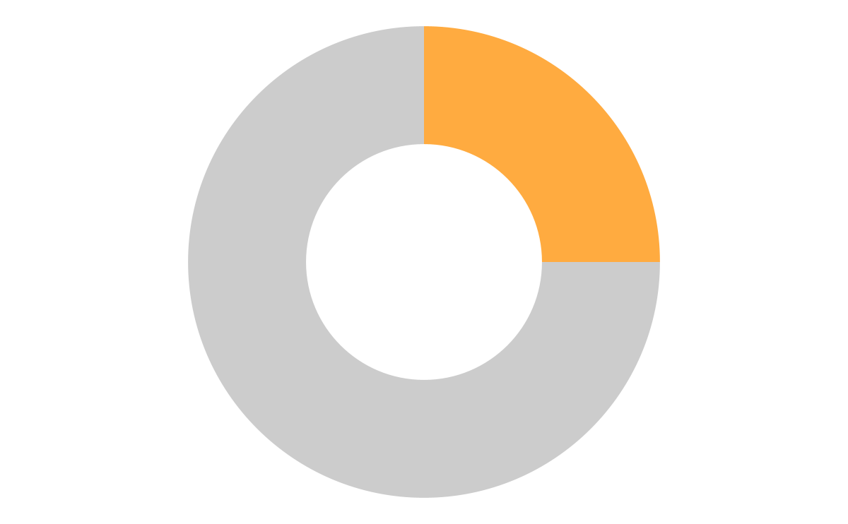


Reason 3: The time of day will impact the quality of my order
2 out of 8 Cx indicated that they abandoned their cart because of previous Mx issues at that time of day
Cx mentioned that they will have items out of stock, or that it will take longer than expected at this time
One Cx said she actually calls the Mx to confirm that everything is in stock and that they have the staff to get to their order quickly
What if we provided more EOD status updates? What if we suppress a Mx if a Cx complains of out of stock?

Slide 10
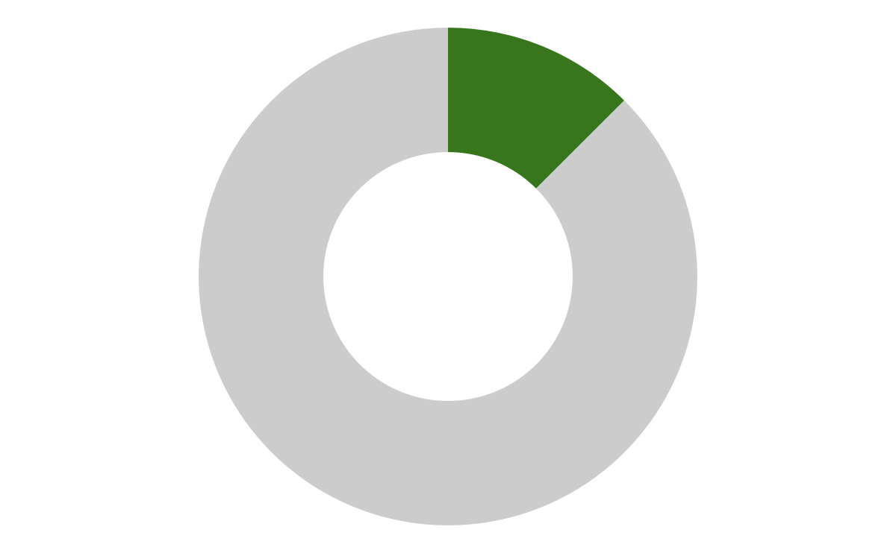
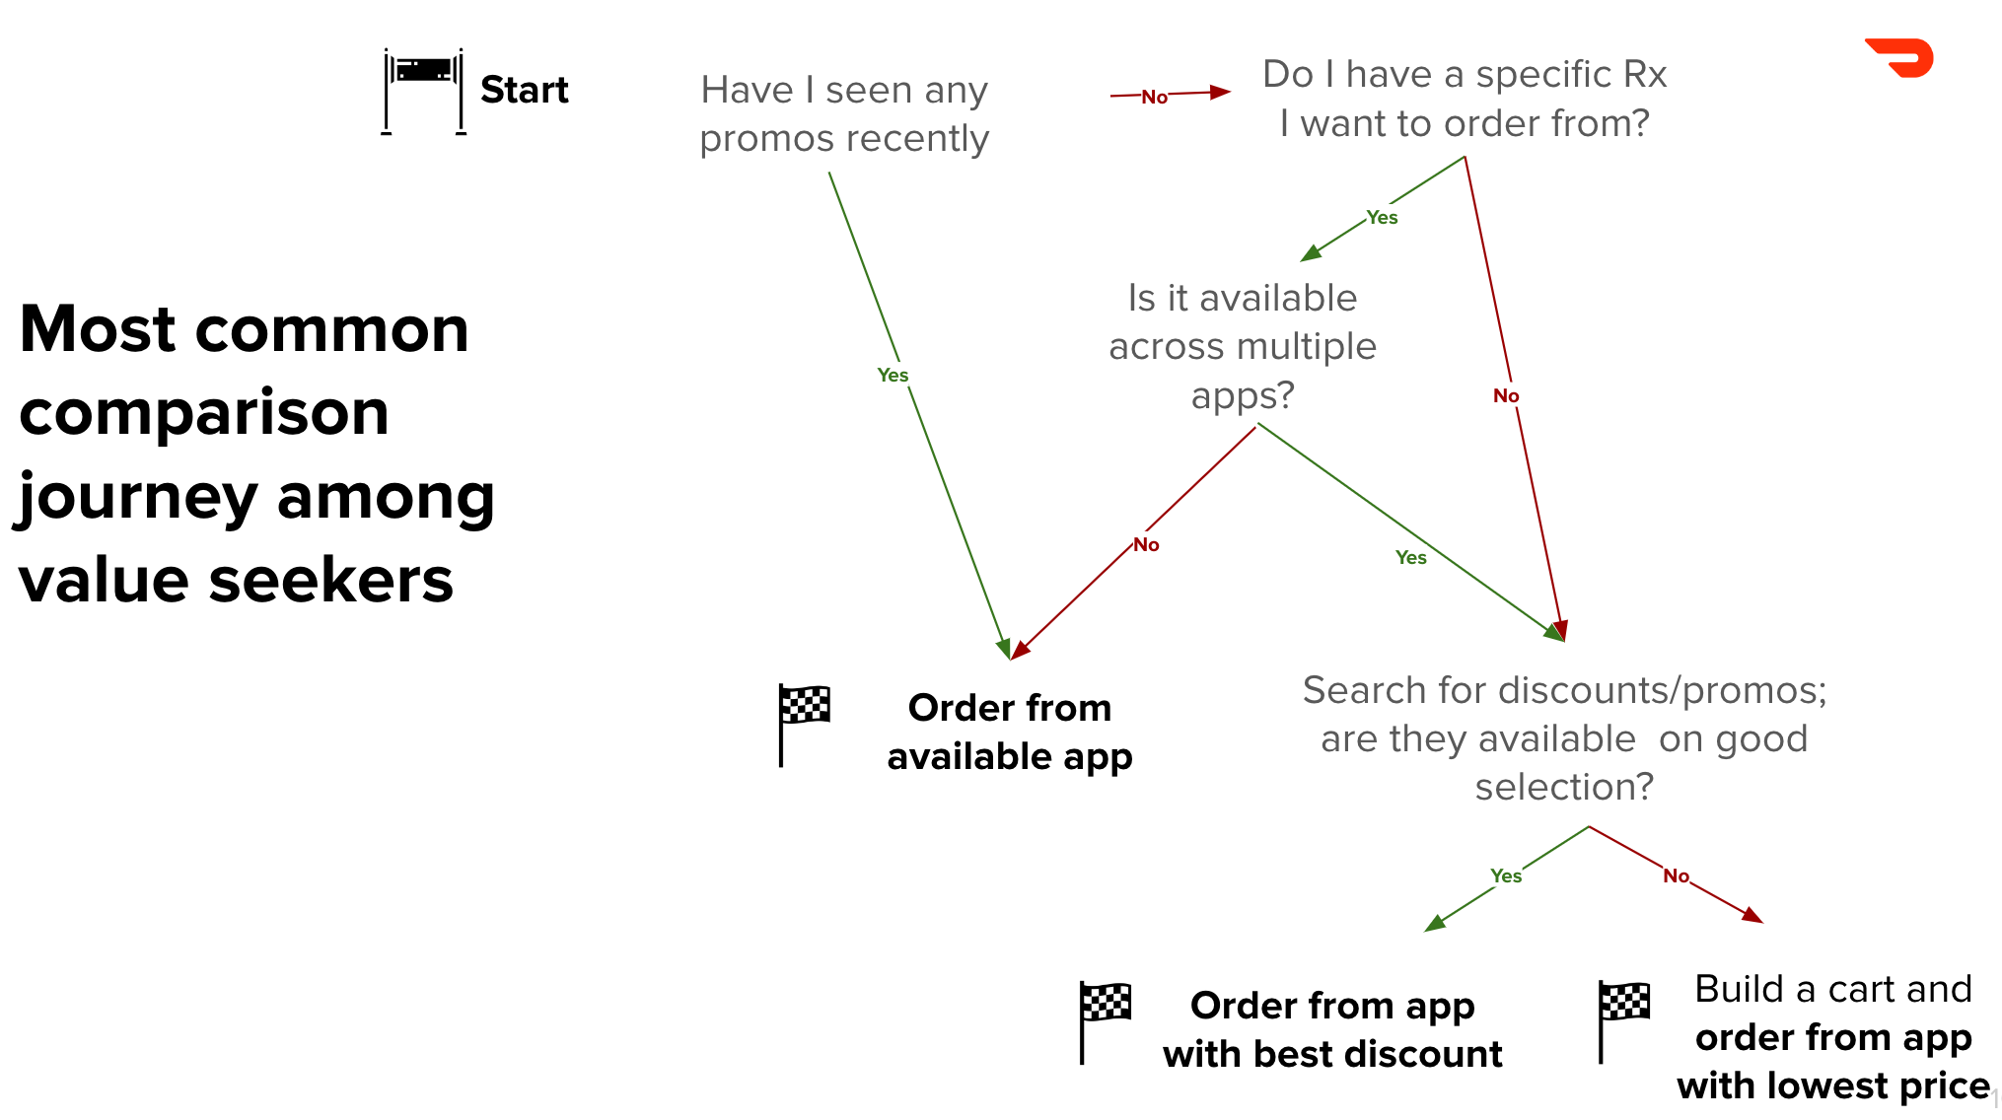
Reason 4: I found it less expensive elsewhere
1 out of 8 Cx indicated they typically compare across apps and will order where they get the best overall subtotal
Learn more about how Cx compare across apps here

Slide 11




Other noted issues/concerns
The ratio of “extra” costs (fees, tax, tip) to the cost of food
The distance/time of order (if coming from a metro area vs. within the suburb)
Previous Dx experience (wrong address)
Existing app preferences (used to use multiple, now rely on one non-DoorDash app)

Slide 12

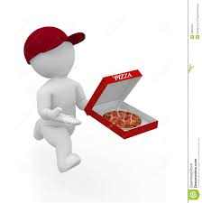

Cx actions after drop off
Did not order/ Cook at home
Order from another app
Go directly to Rx
4 out of 8 Cx
Action for those that the meal did not fit in their budget or cases where there were bad experiences at this time of day
2 out of 8 Cx
This is the case for Cx who had a promo that did not work or were comparison shopping
2 out of 8 Cx
This is the case for Cx who promo did not work

Slide 13
Diving deeper into drop off: Phase II

Slide 14
Next steps: size & define
Draft Survey Outline
Screening Criteria
Profiling
Order DoorDash once a month or less frequently
Visit app in past 48 hours
Drop off from cart in past 48 hours
Does not currently have DashPass subscription or trial
Frequency of delivery by app, direct from Rx and cooking at home
Frequency of ordering by time of day/meal
Budget for time of day/meal
Priorities when selecting what to order
Benefits of takeout/delivery
Individual vs. group order frequency
Sizing Drop off Details
Reason for most recent drop off
Action after most recent drop off
Frequency of drop off
All reasons for drop off
Ranking of frustration for reasons for drop off
Frequency of reasons for drop off
Reactions to potential solutions
Demographics
Age
Employment
HH income
# of individuals in HH
Area where live (metro, suburban, rural)
Zip code where live

Slide 15
Upcoming research

Slide 16
PAD UXR Summer Priorities
Project | Key Research Question | Status | Estimated timing
Occasional Cx Drop Off Phase II Survey | What is the size and frequency of cart drop off by reason? What are the profiles of Cx that drop off for each reason? | Survey development | Mid July
Substitutability & Mx Selection | What are the trade-offs and factors that Cx consider when selecting a Mx. How might they think through other solutions when their initial Mx or item is not available? | Working on timing with analytics | Throughout summer
Defining & communicating value beyond savings | How can we communicate the positive factors of using DoorDash beyond/in addition to savings to increase perceived value? | Scoping | End of July
High frequency, low subtotal Cx vs. Low frequency, high subtotal Cx | How do these Cx differ in terms of motivators, considerations, experiences and values when it comes to takeout? How can we better serve both groups of Cx? | Scoping | Late July
ToDP convert vs. non-convert (August) | What is working, what is not working? How can we continue to evolve ToDP to best meet Cx needs? | Scoping | Early August
Project E.T. Concept Tests (August) | How do Cx feel about project E.T.? Is it clear, exciting, impactful and unique? | Scoping | Late August
Note: KP OOO 7/14 - 7/21 & 8/4-8/9

